Slide 1
CSCI 558L Lecture 10: Programmable Network Cards
Internetworking and Distributed Systems Laboratory
Young Cho
Department of Computer Science
University of Southern California

Slide 2
Programmable Network Interface
Network Processor
Fast Memory for Network
Flexible Design
As Opposed to Traditional NIC
In essence PHY only
Leverages mainboard processor/memory
Memory
Network
Processor
PHY
Network
BUS

Slide 3
Programmable Network Interface
Software Programmable NICs
Intel IQ960-RD66 Evaluation Card
Cyclone Microsystems
http://www.cyclone.com/products/network_adapters/index.php
Quadrics
Myrinet
http://www.myri.com
Hardware/Software Programmable NICs
RiceNIC
http://www.cs.rice.edu/CS/Architecture/ricenic/
NetFPGA
http://www.netfpga.org
Other FPGA based NICs

Slide 4
Network Processor
Terminology emerged in the industry 1997-1998
Many startups competing for the network building-block
Broad variety of products are presented as an NP
Function
Integration and programmability
Efficient processing of network headers in packets
Support for higher-level flow management
Wide spectrum of capabilities and target markets

Slide 5
Motivation
“Flexibility of a fully programmable processor with performance approaching that of a custom ASIC.”
Faster time to market (no ASIC lead time)
Instead you get software development time
Field upgradability leading to longer lifetime
Ability to adapt deployed equipment to evolving and emerging standards and new application spaces
Enables multiple products using common hardware
Allows the network equipment vendors to focus on their value-add

Slide 6
Usage
Integrated GPP + system controller + “acceleration”
Fast forwarding engine with access to a “slow-path” control agent
A smart DMA engine
An intelligent NIC
A highly integrated set of components to replace a bunch of ASICs and the blade control uP

Slide 7
Features
Integrated or attached GPP
Pool of multithreaded forwarding engines
High Bandwidth and High Capacity Mems
Embedded and external SRAM and DRAM
Variety of Communication mediums
Integrated media interface or media bus
Interface to a switching fabric or backplane
Interface to a “host” control processor
Interface to coprocessors

Slide 8
Advantages
Higher Performance
Specialized network processing engines
Multiple processing elements
Low Latency
Intelligence
Network level without going to main processor
Modularity
Taking the processing load off GPP
NP handles the network
GPP handles the application

Slide 9
NP Architectural Challenges
Application-specific architecture
Yet, covering a very broad space with varied (and ill-defined) requirements and no useful benchmarks
Need to understand the environment
Need to understand network protocols
Need to understand networking applications
Have to provide solutions before the actual problem is defined
Decompose into the things you can know
Flows, bandwidths, “Life-of-Packet” scenarios, specific common functions

Slide 10
Simplified Categorization of Applications
Payload Inspection
Real Time
Virus Scanning
TCP Header
Virtual Private Network
Firewall
Packet Inspection Complexity
Application Processing Complexity
IP Header
Load Balancing
Ethernet
Header
Network Monitoring
Quality of Service
Routing
Switching

Slide 11
Application
Forwarding (bridging/routing)
Protocol Conversion
In-system data movement (DMA+)
Encapsulation/Decapsulation to fabric/backplane devices
L4-L7 applications; content and/or flow-based
Security and Traffic Engineering
Firewall, Encryption (IPSEC, SSL), Compression
Rate shaping, QoS/CoS
Intrusion Detection /Prevention (IDS/IPS)
Particularly challenging due to processing many state elements in parallel, unlike most other networking apps which are more likely single-path per packet/cell

Slide 12
Acceleration Techniques (1)
Offload high-touch portions of applications from the uP
Header parsing, checksums/CRCs, RegEx string search
Offload latency-intensive portions to reduce uP stall time
Pointer-chasing in hash table lookups, tree traversals for e.g. routing LPM lookups, fetching of entire packet for high-touch work, fetch of candidate portion of packet for header parsing
Offload compute-intensive portions with specialized engines
Crypto computation, RegEx string search computation, ATM CRC, packet classification (RegEx is mainly bandwidth and stall-intensive)
Provide efficient system management
Buffer management, descriptor management, communications among units, timers, queues, freelists, etc.

Slide 13
Acceleration Techniques (2)
Media processing (framing etc)
Specialized units
Decouple hard real-time from budgeted-time
meet per-packet/cell time budgets
higher level processing via buffering (e.g. IP frag reass’y, TCP stream assembly and processing etc.)
Efficient communication among units
Hardware and software must be well architected and designed to avoid this.
Keep compute:communicate ratio high.

Slide 14
Acceleration via Pipelining
Goal is to increase total processing time per packet/cell by providing a chain of pipelined processing units
May be specialized hardware functions
May be flexible programmable elements
Might be lockstep or elastic pipeline
Communication costs between units must be minimized to ensure a compute:communicate ratio that makes the extra stages a win
Possible to hide some memory latency by having a predecessor request data for a successor in the pipeline
If a successor can modify memory state seen by a predecessor then there is a “time-skew” consistency problem that must be addressed

Slide 15
Acceleration via Parallelism
Goal is to increase total processing time per packet/cell by providing several processing units in parallel
Generally these are identical programmable units
May be symmetric (same program/microcode) or asymmetric
If asymmetric, an early stage disaggregates different packet types to the appropriate type of unit (visualize a pipeline stage before a parallel farm)
Keeping packets ordered within the same flow is a challenge
Dealing with shared state among parallel units requires some form of locking and/or sequential consistency control which can eat some of the benefit of parallelism
Caveat; more parallel activity increases memory contention, thus latency

Slide 16
Latency Hiding via Hardware Multi-Threading
Goal is to increase utilization of a hardware unit by sharing most of the unit, replicating some thread state, and switching to processing a different packet on a different thread while waiting for memory
Specialized case of parallel processing, with less hardware
Good utilization is under programmer control
Generally non-preemptable (explicit yield model instead)
As the ratio of memory latency to clock rate increases, more threads are needed to achieve the same utilization
Has all of the consistency challenges of parallelism plus a few more (e.g. spinlock hazards)
Opportunity for quick state sharing thread-to-thread, potentially enabling software pipelining within a group of threads on the same engine (threads may be asymmetric)

Slide 17
Coprocessors: NP’s for NP’s
Sometimes specialized hardware is the best way to get the required speed for certain functions
Many NP’s provide a fast path to external coproc’s; sometimes slave devices, sometime masters.
Variety of functions
Encryption and Key Management
Lookups, CAMs, Ternary CAMs
Classification
RegEx string searches (often on reassembled frames)
Statistics gathering

Slide 18
A Typical NP Architecture
Physical
Interface
Network
DMA/Buffer
General
Purpose
Processor
Coproc
Interface
Network
(i.e. GbE)
Internal BUS
Memory
Memory
Interface
DMA/BUS
Interface
Coproc
To main BUS (i.e. PCI-Express)

Slide 19
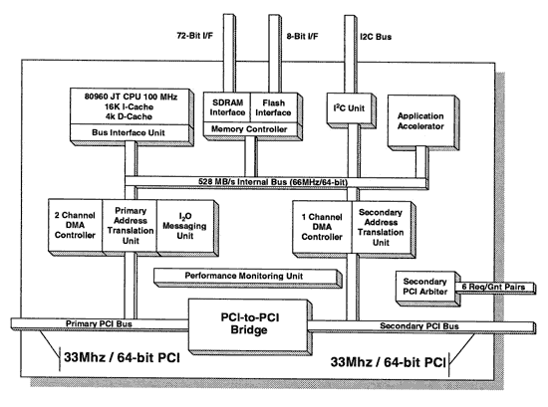
Intel i960

Slide 20
Intel i960
Embedded Processor
I/O Processor
Peer-to-peer
Network Processor
PCI Interface
One to the Main BUS
Other to the Network Interface
Similar to Myrinet LANai
Further development leading into IXA?

Slide 21
Intel IXA
Current Routers
Involve general purpose CPUs
Lots of ASICs (Application Specific Integrated Circuits ).
The ASICs are necessary to keep up with the quantity and rate of the network traffic.
The StrongARM Core
Replace the general purpose CPUs
Microengines
Replace the bulk of the ASICs
Actually inherited IXA when they bought Digital.

Slide 22
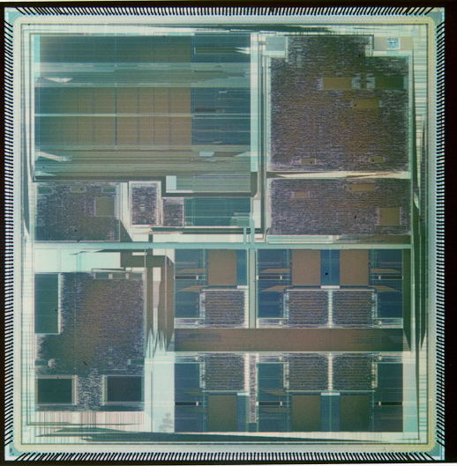
Intel IXP1200 NP
Very Low Power Parallel Processor Architecture with 7 232 MHz RISC processors
Hardware Based Multithreading on 6 RISC engines - Cost Effective
Distributed Data Storage Arch Supports Very Simple Programming Model
Active Memory Optimizations - High Performance With Commodity RAMs
Scalable Architecture
StrongARM Core
PCI
PCI
SRAM
SRAM
SDRAM
SDRAM
IX Bus
IX Bus
6 RISC Engines
Notes:
This foil highlights the features of the IXP1200 which also exist in the IXP1240 and IXP1250 NPs
The wide range of packet handling and control functionality integrated into the IXP1200 Network Processor enables equipment developers to focus on development of new features and services

Slide 23
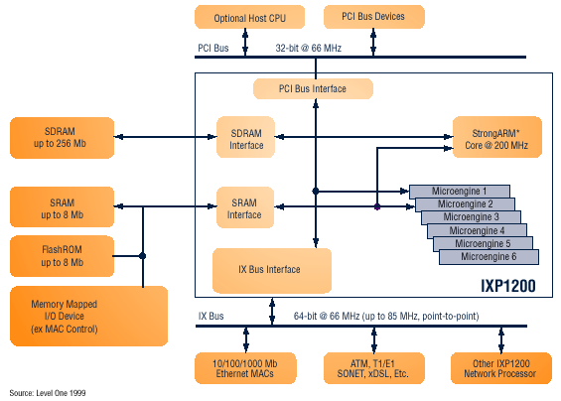
Intel IXP 1200 Block Diagram

Slide 24
IXP2400 Features
Interface supports UTOPIA 1/2/3, SPI-3 (POS-PL3), and CSIX.
Four independent, configurable, 8-bit channels with the ability to aggregate channels for wider interfaces.
Media interface can support channelized media on RX and 32-bit connect to Switch Fabric over SPI-3 on TX (and vice versa) to support Switch Fabric option.
Two Quad Data Rate SRAM channels.
A QDR SRAM channel can interface to Co-Processors.
One DDR DRAM channel.
PCI 64/66 Host CPU interface.
Flash and PHY Mgmt interface.
Dedicated inter-IXP channel to communicate fabric flow control information from egress to ingress for dual chip solution.
Host
CPU
(Optional)
Classification Accelerator
QDR SRAM
20 Gbps
32 M Byte
IXP2400
(Receive)
DDR DRAM
2 GByte
Micro-Engine
Cluster
Customer ASICs
IXP2400
(Transmit)
Flash
Utopia 1/2/3 or
POS-PL2/3
Interface
Switch Fabric Port Interface
ATM / POS PHY
or Ethernet MAC

Slide 25
Microengine V2
From Next Neighbor
D-Push Bus
S-Push Bus
Control
Store
4K
Instructions
Local
Memory
128
GPR
128
GPR
128 Next
Neighbor
128 D
Xfer In
128 S
Xfer In
LM Addr 1
2 per CTX
LM Addr 0
P-Random #
A_Operand
B_Operand
CRC Unit
CAM
Multiply
Execution Data path
CRC remain
Find first bit
Local
CSRs
Add, shift, logical
ALU_Out
To Next Neighbor
128 D
Xfer Out
128 S
Xfer Out
D-Pull Bus
S-Pull Bus

Slide 26
IXP 2400
Eight next generation Microengines (MEv2)
Operating at 600MHz
Automated packet scheduling and handling
Local data store enables higher performance
Hardware acceleration for DiffServ, MPLS, and other QoS schemes
ATM Segmentation and Reassembly (SAR) support with headroom.
Intel® XscaleTM microarchitecture core operating at 600MHz

Slide 27
Myrinet
Processor on Myrinet NIC
Leading Interface card for Clustering
Offload Network processing from main Processor
One of the first “Network Processor”
Pipelined RISC processor
General Purpose Processor
Fully functional GCC with libraries
Interfaces
Network (Myrinet – High BW/Low Latency)
SRAM Memory Interface
BUS Interface

Slide 28
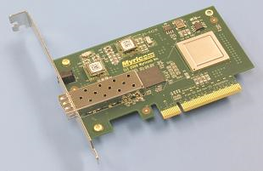
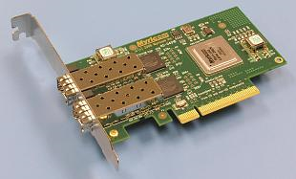
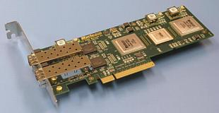
Myrinet Cards

Slide 29
Flexibility
Physical Links are 10-Gigabit Ethernet
10+10 Gigabits per second, full-duplex.
Converted to other 10-Gigabit Ethernet PHYs.
At the Data-Link level, the links may be either Ethernet or Myrinet
Software support
MX-10G is the low-level message-passing system for the Myri-10G
Includes ethernet emulation (TCP/IP, UDP/IP)
10-Gigabit Ethernet drivers (A matter of Firmware)
Performance with the Myri-10G PCI-Express NICs
Myrinet mode: 2µs MPI latency with 1.2 GBytes/s one-way
10-Gigabit Ethernet mode, 9.6 Gbits/s TCP/IP rate

Slide 30
Next
Next Lecture
Hardware Accelerated Network Appliances
Laboratory
Lab 5: Due on Oct 1 at 11:55pm
Reading Assignment
DETER team, "Cyber defense technology networking and evaluation", In Communications of the ACM, Special issue on Emerging Technologies for Homeland Security, Vol. 47, Issue 3, pp 58-61, March 2004.

